Slide 1
i=0
j=0
L
14
23
45
98
R
6
33
42
67

Slide 2
Merge
i=0
j=0
L
14
23
45
98
R
6
33
42
67
A

Slide 3
Merge
i=0
j=1
L
14
23
45
98
R
6
33
42
67
A
6
k=0

Slide 4
Merge
i=1
j=1
L
14
23
45
98
R
6
33
42
67
A
6
14
k=1

Slide 5
Merge
i=2
j=1
L
14
23
45
98
R
6
33
42
67
A
6
14
23
k=2

Slide 6
Merge
i=2
j=2
L
14
23
45
98
R
6
33
42
67
A
6
14
23
33
k=3

Slide 7
Merge
i=2
j=3
L
14
23
45
98
R
6
33
42
67
A
6
14
23
33
42
k=4

Slide 8
Merge
i=3
j=3
L
14
23
45
98
R
6
33
42
67
A
6
14
23
33
42
45
k=5

Slide 9
Merge
i=3
j=4
L
14
23
45
98
R
6
33
42
67
A
6
14
23
33
42
45
67
k=6

Slide 10
Merge
i=4
j=4
L
14
23
45
98
R
6
33
42
67
A
6
14
23
33
42
45
67
98
k=7

Slide 11
Merge(L,R,A) {
nL = length(L)
nR = length(R)
i= j = k = 0
while(i< nL && j< nR) {
if(L[i] <= R[j]) {
A[k] = L[i]
i= i+1
}
else {
A[k] = R[j]
j= j+1
}
k= k+1
}
while( i<nL) {
A[k] = L[i]; i=i+1; k=k+1;
}
while (j<nR) {
A[k] = R[i]; j=j+1; k=k+1;
}
}
n*c0+ n*c1+n*c2+ c4
=n*(c0+c1+c2) + c4
=n*c3 + c4

Slide 12
nL = length(L)
nR = length(R)
i= j = k = 0
i=0
j=0
L
14
23
45
98
R
6
33
42
67

Slide 13
while(i< nL && j< nR) {
If(L[i] <= R[j]) {
A[k] = L[i]
i= i+1
}
else {
A[k] = R[j]
j= j+1
}
k= k+1
}
i=0
j=0
L
14
23
45
98
R
6
33
42
67
A

Slide 14
while(i< nL && j< nR) {
If(L[i] <= R[j]) {
A[k] = L[i]
i= i+1
}
else {
A[k] = R[j]
j= j+1
}
k= k+1
}
i=0
j=1
L
14
23
45
98
R
6
33
42
67
A
6
k=0

Slide 15
while(i< nL && j< nR) {
If(L[i] <= R[j]) {
A[k] = L[i]
i= i+1
}
else {
A[k] = R[j]
j= j+1
}
k= k+1
}
i=1
j=1
L
14
23
45
98
R
6
33
42
67
A
6
14
k=1

Slide 16
while(i< nL && j< nR) {
If(L[i] <= R[j]) {
A[k] = L[i]
i= i+1
}
else {
A[k] = R[j]
j= j+1
}
k= k+1
}
i=2
j=1
L
14
23
45
98
R
6
33
42
67
A
6
14
23
k=2

Slide 17
while(i< nL && j< nR) {
If(L[i] <= R[j]) {
A[k] = L[i]
i= i+1
}
else {
A[k] = R[j]
j= j+1
}
k= k+1
}
i=2
j=2
L
14
23
45
98
R
6
33
42
67
A
6
14
23
33
k=3

Slide 18
while(i< nL && j< nR) {
If(L[i] <= R[j]) {
A[k] = L[i]
i= i+1
}
else {
A[k] = R[j]
j= j+1
}
k= k+1
}
i=2
j=3
L
14
23
45
98
R
6
33
42
67
A
6
14
23
33
42
k=4

Slide 19
while(i< nL && j< nR) {
If(L[i] <= R[j]) {
A[k] = L[i]
i= i+1
}
else {
A[k] = R[j]
j= j+1
}
k= k+1
}
i=3
j=3
L
14
23
45
98
R
6
33
42
67
A
6
14
23
33
42
45
k=5

Slide 20
while(i< nL && j< nR) {
If(L[i] <= R[j]) {
A[k] = L[i]
i= i+1
}
else {
A[k] = R[j]
j= j+1
}
k= k+1
}
i=3
j=4
L
14
23
45
98
R
6
33
42
67
A
6
14
23
33
42
45
67
k=6

Slide 21
while(i< nL && j< nR) {
If(L[i] <= R[j]) {
A[k] = L[i]
i= i+1
}
else {
A[k] = R[j]
j= j+1
}
k= k+1
}
i=3
j=4
L
14
23
45
98
R
6
33
42
67
A
6
14
23
33
42
45
67
k=6

Slide 22
while( i<nL) {
A[k] = L[i];
i=i+1;
k=k+1;
}
while (j<nR) {
A[k] = R[i];
j=j+1;
k=k+1;
}
i=3
j=4
L
14
23
45
98
R
6
33
42
67
A
6
14
23
33
42
45
67
k=6

Slide 23
while( i<nL) {
A[k] = L[i];
i=i+1;
k=k+1;
}
while (j<nR) {
A[k] = R[i];
j=j+1;
k=k+1;
}
i=4
j=4
L
14
23
45
98
R
6
33
42
67
A
6
14
23
33
42
45
67
98
k=7

Slide 24
MergeSort

Slide 25
MergeSort
MergeSort is a divide and conquer method of sorting
25

Slide 26
Merge-Sort Tree
An execution of merge-sort is depicted by a binary tree
each node represents a recursive call of merge-sort and stores
unsorted sequence before the execution and its partition
sorted sequence at the end of the execution
the root is the initial call
the leaves are calls on subsequences of size 0 or 1
7 2 ⏐ 9 4 → 2 4 7 9
7 ⏐ 2 → 2 7
9 ⏐ 4 → 4 9
7 → 7
2 → 2
9 → 9
4 → 4
26
Notes:
26

Slide 27
Execution Example
Partition
7 2 9 4 ⏐ 3 8 6 1
2 4 7 9
1 3 6 8
1 2 3 4 6 7 8 9
27
Notes:
27

Slide 28
Execution Example
Partition
7 2 9 4 ⏐ 3 8 6 1
28
Notes:
28

Slide 29
Execution Example (cont.)
Recursive call, partition
7 2 9 4 ⏐ 3 8 6 1
7 2 ⏐ 9 4
29
Notes:
29

Slide 30
Execution Example (cont.)
Recursive call, partition
7 2 9 4 ⏐ 3 8 6 1
7 2 ⏐ 9 4
7 ⏐ 2
30

Slide 31
Execution Example (cont.)
Recursive call, base case
7 2 9 4 ⏐ 3 8 6 1
7 2 ⏐ 9 4
7 ⏐ 2
7 → 7
31

Slide 32
Execution Example (cont.)
Recursive call, base case
7 2 9 4 ⏐ 3 8 6 1
7 2 ⏐ 9 4
7 ⏐ 2
7 → 7
2 → 2
32

Slide 33
Execution Example (cont.)
Merge
7 2 9 4 ⏐ 3 8 6 1
7 2 ⏐ 9 4
7 ⏐ 2 → 2 7
7 → 7
2 → 2
33

Slide 34
Execution Example (cont.)
Recursive call, …, base case, merge
7 2 9 4 ⏐ 3 8 6 1
7 2 ⏐ 9 4
7 ⏐ 2 → 2 7
9 4 → 4 9
7 → 7
2 → 2
9 → 9
4 → 4
34

Slide 35
Execution Example (cont.)
Merge
7 2 9 4 ⏐ 3 8 6 1
7 2 ⏐ 9 4 → 2 4 7 9
7 ⏐ 2 → 2 7
9 4 → 4 9
7 → 7
2 → 2
9 → 9
4 → 4
35

Slide 36
Execution Example (cont.)
Recursive call, …, merge, merge
7 2 9 4 ⏐ 3 8 6 1
7 2 ⏐ 9 4 → 2 4 7 9
3 8 6 1 → 1 3 6 8
7 ⏐ 2 → 2 7
9 4 → 4 9
3 8 → 3 8
6 1 → 1 6
7 → 7
2 → 2
9 → 9
4 → 4
3 → 3
8 → 8
6 → 6
1 → 1
36

Slide 37
Execution Example (cont.)
Merge
7 2 9 4 ⏐ 3 8 6 1 → 1 2 3 4 6 7 8 9
7 2 ⏐ 9 4 → 2 4 7 9
3 8 6 1 → 1 3 6 8
7 ⏐ 2 → 2 7
9 4 → 4 9
3 8 → 3 8
6 1 → 1 6
7 → 7
2 → 2
9 → 9
4 → 4
3 → 3
8 → 8
6 → 6
1 → 1
37

Slide 38
Mergesort(A)
{
n = length(A)
if(n<2) return
mid = n/2
L = array of size(mid)
R = array of size(n-mid)
for(i=0; i < mid; i++)
L[i] = A[i]
for(i=mid; i < n; i++)
R[i-mid] = A[i]
Mergesort(L)
Mergesort(R)
Merge(L , R , A)
}
7 2 9 4 ⏐ 3 8 6 1 → 1 2 3 4 6 7 8 9
7 2 ⏐ 9 4 → 2 4 7 9
3 8 6 1 → 1 3 6 8
7 ⏐ 2 → 2 7
9 4 → 4 9
3 8 → 3 8
6 1 → 1 6
7 → 7
2 → 2
9 → 9
4 → 4
3 → 3
8 → 8
6 → 6
1 → 1
38

Slide 39
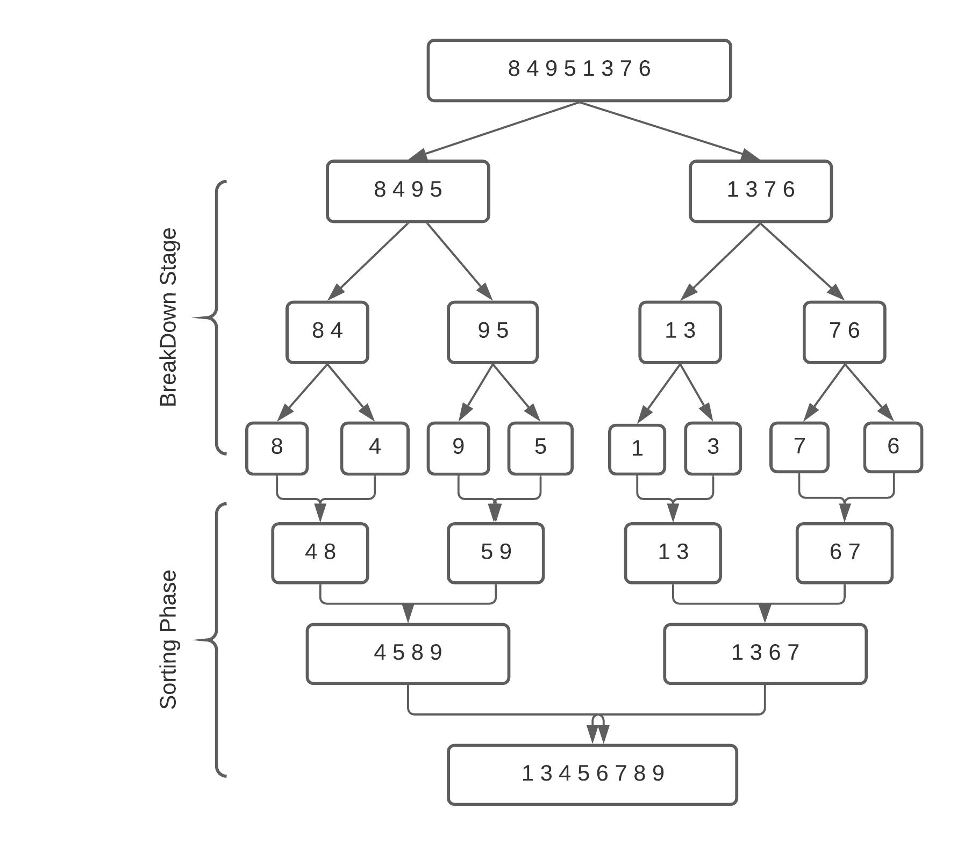

Slide 40
Merge Sort Analysis
The divide step takes constant time, regardless of the subarray size. After all, the divide step just computes the midpoint q of the indices p and r. Recall that in big-O notation, we indicate constant time by O(1).
The conquer step, where we recursively sort two subarrays of approximately n/2 elements each, takes some amount of time, but we'll account for that time when we consider the subproblems.
The combine step merges a total of n elements, taking O(n) time.

Slide 41
Mergesort(A) { | T(n), to sort n elements
n = length(A) if(n<2) return mid = n/2 L = array of size(mid) R = array of size(n-mid) | c1
for(i=0; i < mid; i++) L[i] = A[i] for(i=mid; i < n; i++) R[i-mid] = A[i] | c2* (n/2) + c2* (n/2) =c2( n/2 + n/2) =c2 * n
Mergesort(L) | T(n/2)
Mergesort(R) | T(n/2)
Merge(L , R , A) | c3.n+c4
}
So T(n) = O(1) when n = 1, and 2T(n/2) + (c2+c3)*n + (c1+c4) when n > 1

Slide 42
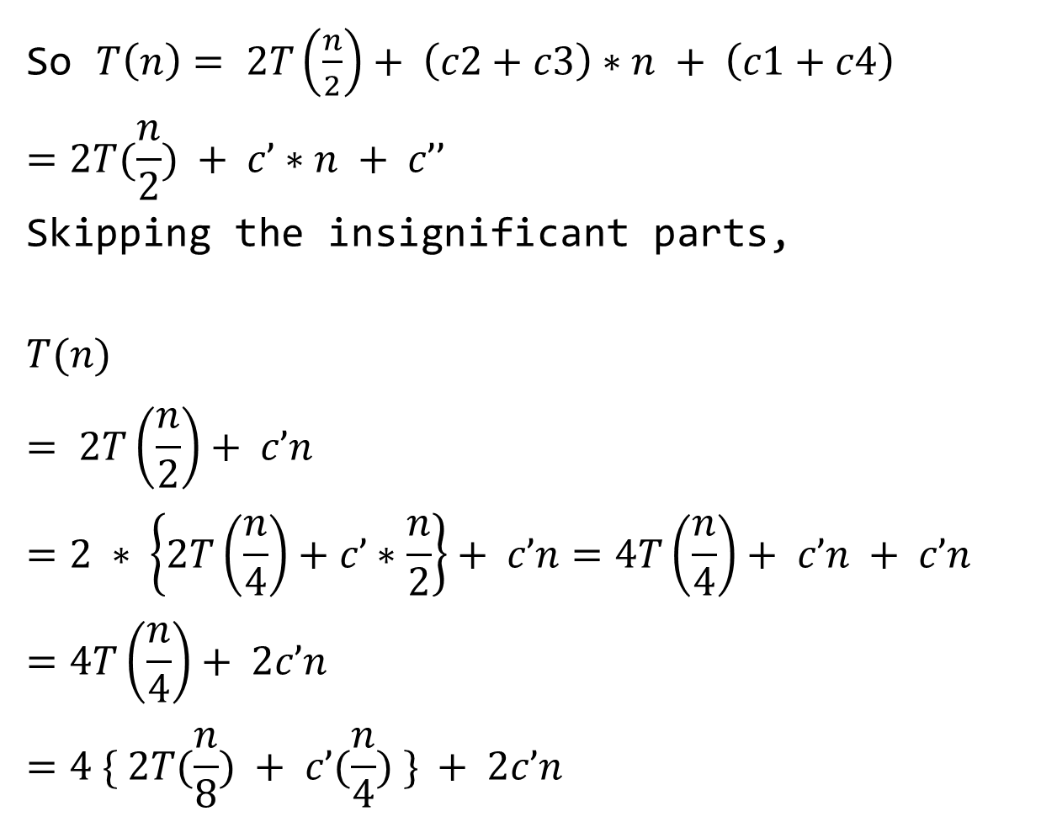
So $T\left(n\right)= 2T\left(\frac{n}{2}\right)+ \left(c2+c3\right)∗n + \left(c1+c4\right)$
$$=2T(\frac{n}{2}) + c’∗n + c’’$$
Skipping the insignificant parts,
$$T(n)$$
$$= 2T\left(\frac{n}{2}\right)+ c’n$$
$$=2 ∗ \left\{2T\left(\frac{n}{4}\right)+c’∗\frac{n}{2}\right\}+ c’n=4T\left(\frac{n}{4}\right)+ c’n + c’n$$
$$=4T\left(\frac{n}{4}\right)+ 2c’n$$
$$=4 \{ 2T(\frac{n}{8}) + c’(\frac{n}{4}) \} + 2c’n$$

Slide 43
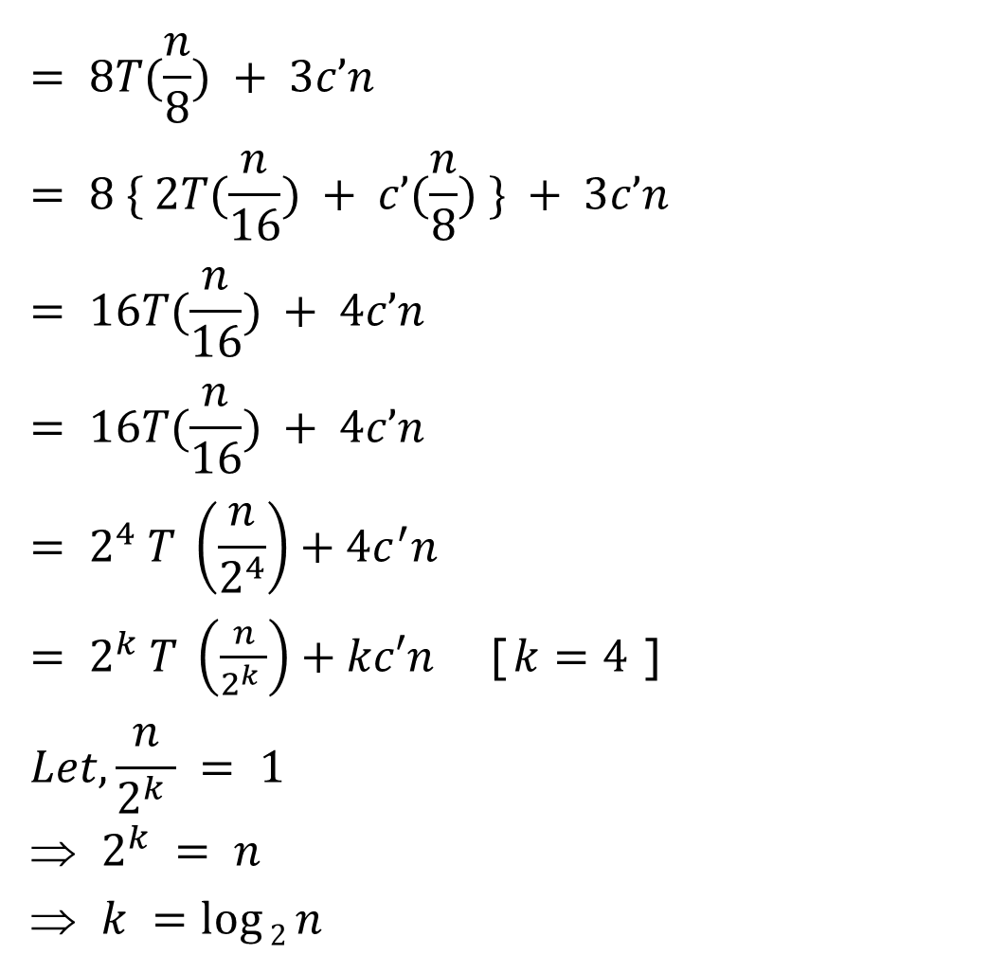
$$= 8T(\frac{n}{8}) + 3c’n$$
$$= 8 \{ 2T(\frac{n}{16}) + c’(\frac{n}{8}) \} + 3c’n= 16T(\frac{n}{16}) + 4c’n$$
$$= 16T(\frac{n}{16}) + 4c’n$$
$$= 2^{4} T \left(\frac{n}{2^{4}}\right)+4c^{′}n$$
$= 2^{k} T \left(\frac{n}{2^{k} }\right)+kc′n$ [$k=4$]
$$Let, \frac{n}{2^{k} } = 1$$
$2^{k} = n$
$k =\log{2}n$

Slide 44
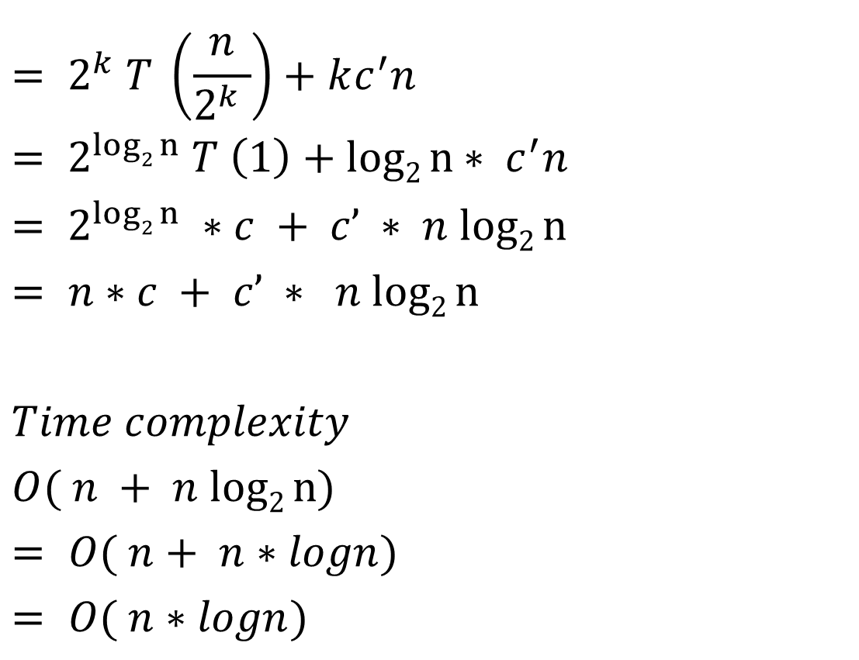
$$= 2^{k} T \left(\frac{n}{2^{k} }\right)+kc^{′}n$$
$$= 2^{log2 n} T \left(1\right)+log2 n∗ c^{′}n$$
$$= 2^{log2 n} ∗c + c’ ∗ n log2 n= n∗c + c’ ∗ n log2 n$$
$$Time complexity$$
$$O( n + n log2 n)$$
$$= O( n+ n∗logn)$$
$$= O( n∗logn)$$

Slide 45
Best Case Time Complexity: O(n*log n)
Worst Case Time Complexity: O(n*log n)
Average Time Complexity: O(n*log n)
The time complexity of MergeSort is O(n*Log n) in all the 3 cases (worst, average and best) as the mergesort always divides the array into two halves and takes linear time to merge two halves.

